Slide 1
Online Hate Crimes: A Growing Issue
By: Sam Mendez
11/28/2025

Slide 2
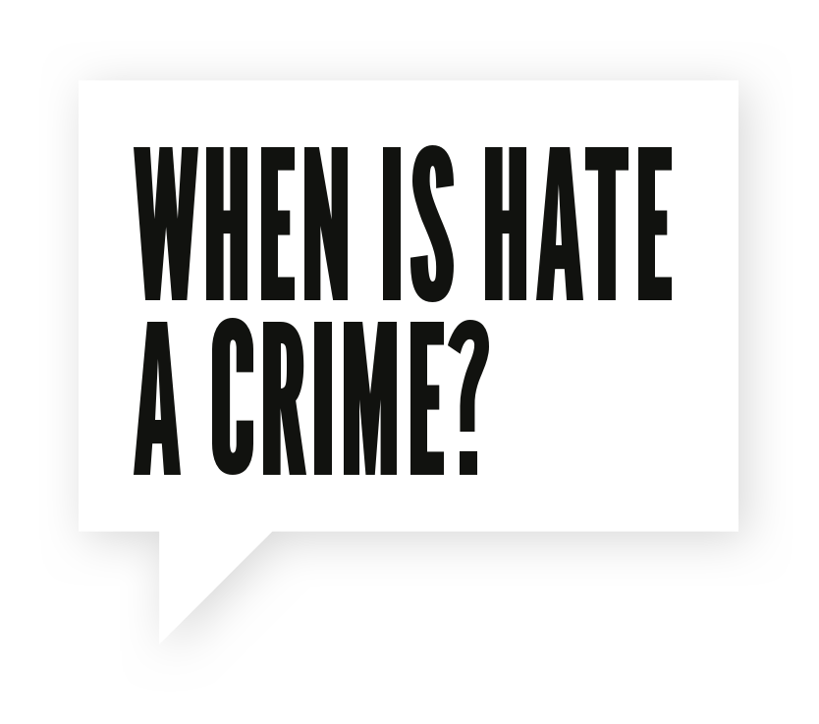
What Are Online Hate Crimes?
Definition: Bias-motivated crimes targeting identity groups.
Digital platforms amplify the reach and impact of these crimes.
Focus: Recent West Virginia case and its implications.

Slide 3
A Case in Focus: The West Virginia Hate Crime
Summary: Threats to jurors and witnesses during the Tree of Life Synagogue trial.
Methods: Emails and social media threats.
Motivation: Religious hatred against the Jewish faith.
Outcome: Six and a half years prison sentence.

Slide 4
Defining Characteristics
Identity-based targeting: religion, race, gender, etc.
Intent to harm, intimidate, or spread fear.
Amplified by online platforms: anonymity and global reach.
Often linked to extremist ideologies.

Slide 5
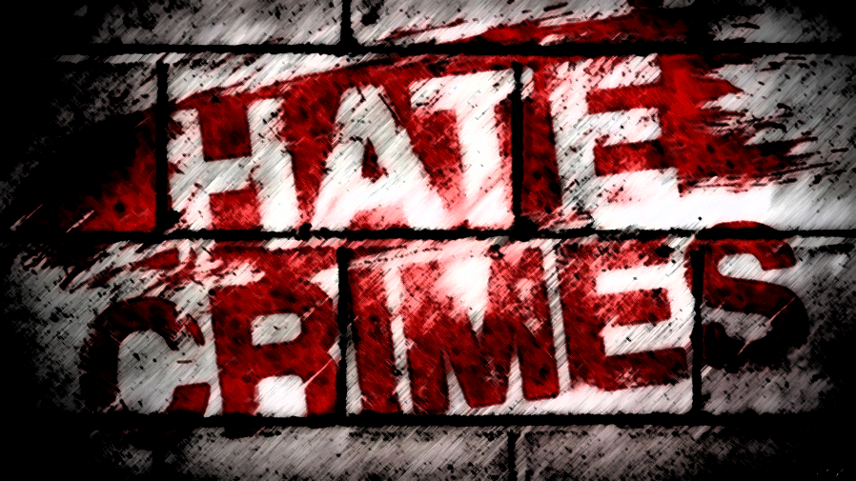
The Ripple Effect of Online Hate
Victims: Psychological trauma, fear, and isolation.
Communities: Social division and loss of trust.
Potential for escalation into real-world violence.
Challenges: Addressing anonymous perpetrators.

Slide 6

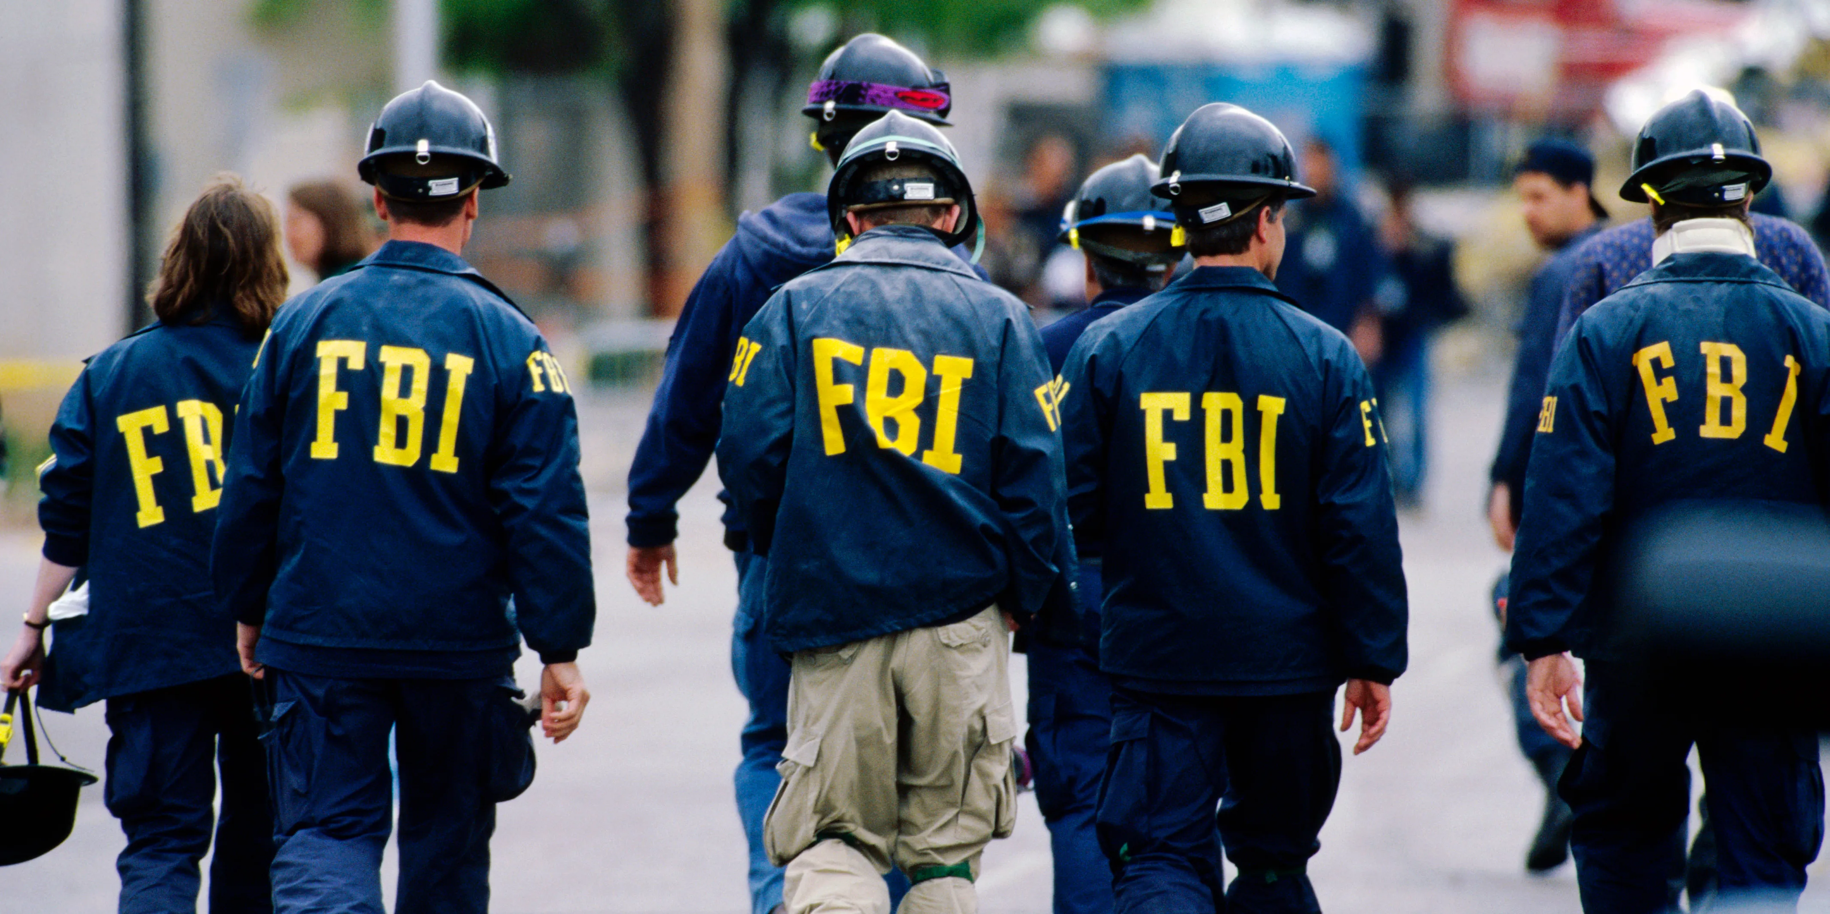

How Law Enforcement Responds
FBI prioritizes hate crimes as a national threat.
Use of digital evidence to identify and prosecute offenders.
Collaboration with communities and task forces.

Slide 7

Impacts on Society and the Legal System
Legal consequences: Strict sentencing as a deterrent.
Platform regulation challenges: Hate speech vs. free speech.
Inconsistent enforcement of platform policies.
Need to address root causes of bias and hatred.

Slide 8
Solutions to Combat Online Hate
Education: Teach recognition and reporting of hate crimes.
Strengthen community resilience and inclusivity.
Collaboration between governments, law enforcement, and tech companies.
Encourage proactive content moderation on platforms.

Slide 9
Working Together to Reduce Hate Crimes
Summary: Online hate crimes require collective action.
Key takeaway: Collaboration among stakeholders is essential.
Call to action: Report and oppose hate crimes actively.

